Slide 1
Course : COMP8029 – IT Security and Risk Management
Period : September / February 20XX
Technical aspect of Information Security
Session 05
KDS – Name SME

Slide 2
Cryptography
Cryptography
  In a narrow sense
    Mangling information into apparent unintelligibility
    Allowing a secret method of un-mangling
  In a broader sense
    Mathematical techniques related to information security
    About secure communication in the presence of adversaries
Cryptanalysis
  The study of methods for obtaining the meaning of encrypted information without accessing the secret information
Cryptology
  Cryptography + cryptanalysis
Bina Nusantara University

Slide 3
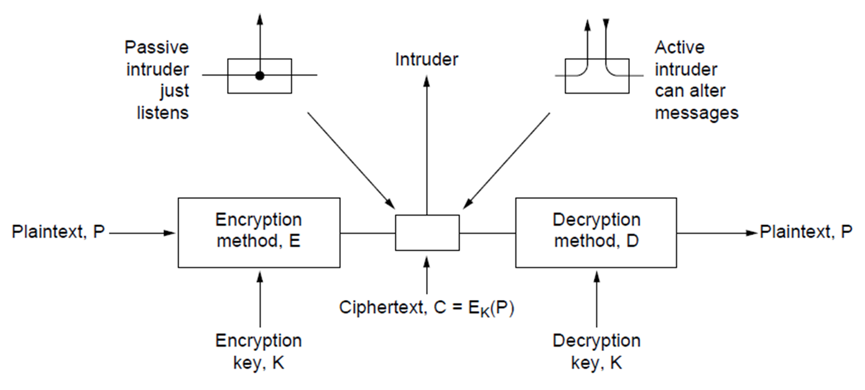
Introduction
Bina Nusantara University

Slide 4
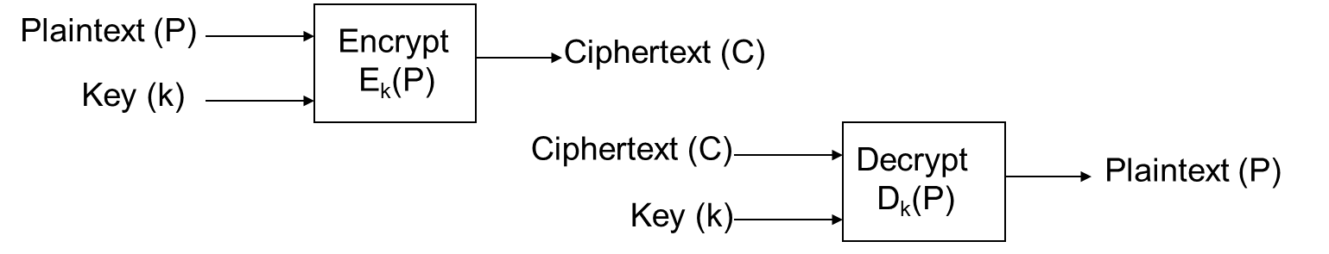
Symmetric Key cryptographic algorithms use a secret known to the authorized parties called a “key”. Encryption and Decryption use the same key.
  The transformations are simple and fast enough for practical use and implementation.
  “Keyspace” large enough to protect against exhaustive search.
  The encryption algorithm must be efficiently invertible.
  Two major types: Stream ciphers and Block ciphers
Bina Nusantara University

Slide 5
Security Attacks
Passive attacks
  Obtain message contents
  Monitoring traffic flows
Active attacks
  Masquerade of one entity as some other
  Replay previous messages
  Modify messages in transmit
  Add, delete messages
  Denial of service
Bina Nusantara University

Slide 6
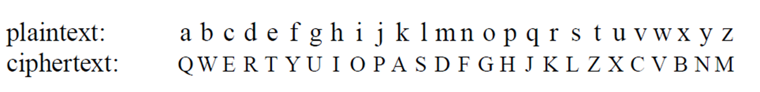
Substitution Cipher
Bina Nusantara University

Slide 7
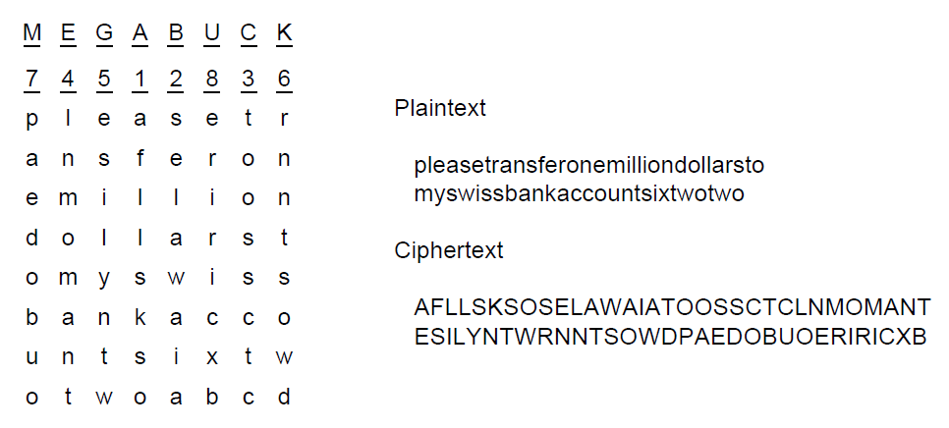
Transposition Ciphers
Bina Nusantara University

Slide 8
Public-key Algorithms
RSA
  Authors: Rivest, Shamir, Adleman
Method Summary
Choose two large primes, p and q
Compute
n = p × q and z = ( p − 1) × (q − 1).
Choose number relatively prime to z
call it d.
Find e such that e × d = 1 mod z.
Bina Nusantara University

Slide 9
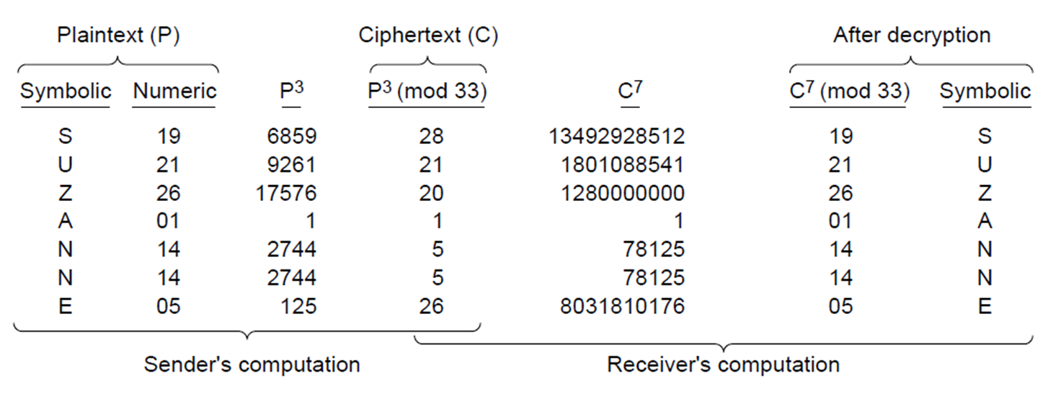
Bina Nusantara University

Slide 10
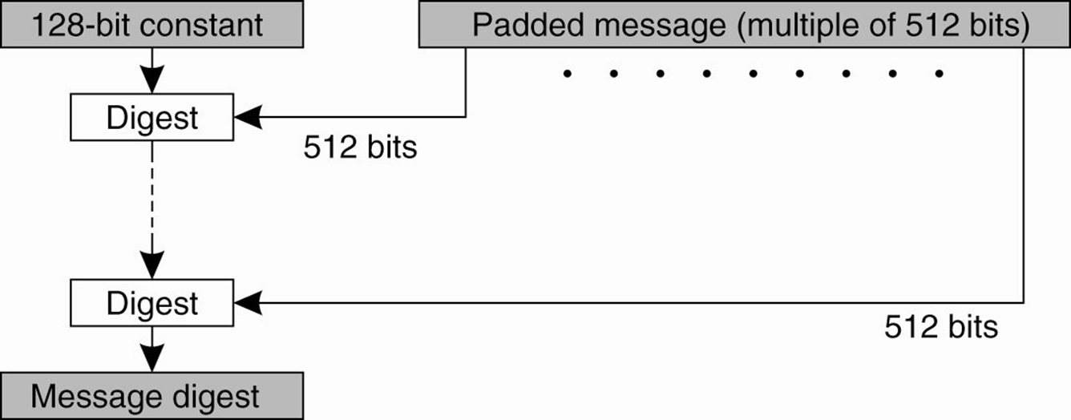
Hash Functions: MD5
Bina Nusantara University

Slide 11
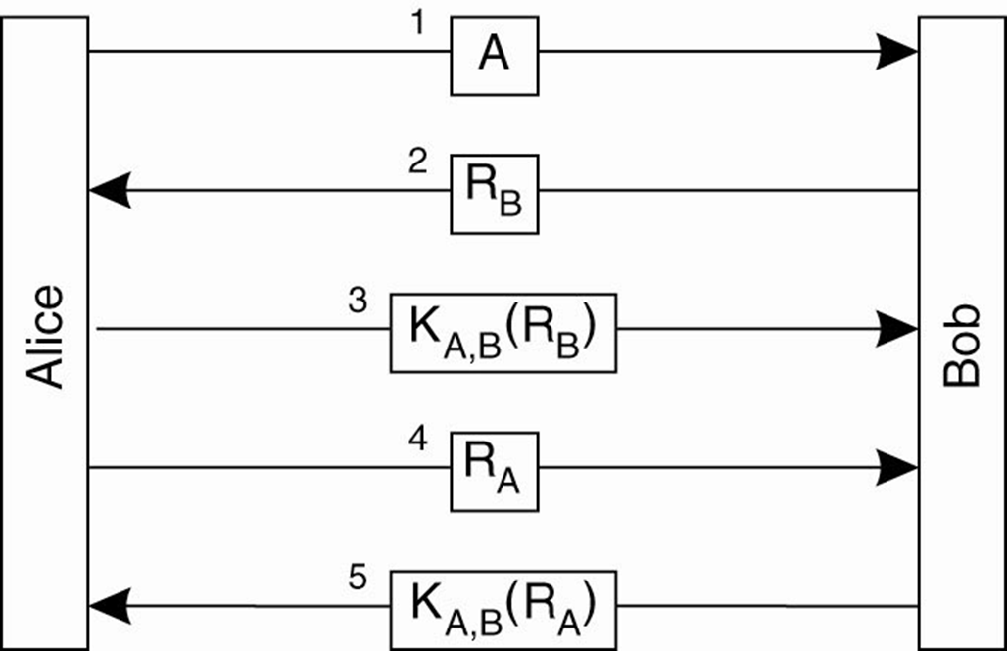
Authentication Based on a Shared Secret Key (1)
Bina Nusantara University

Slide 12
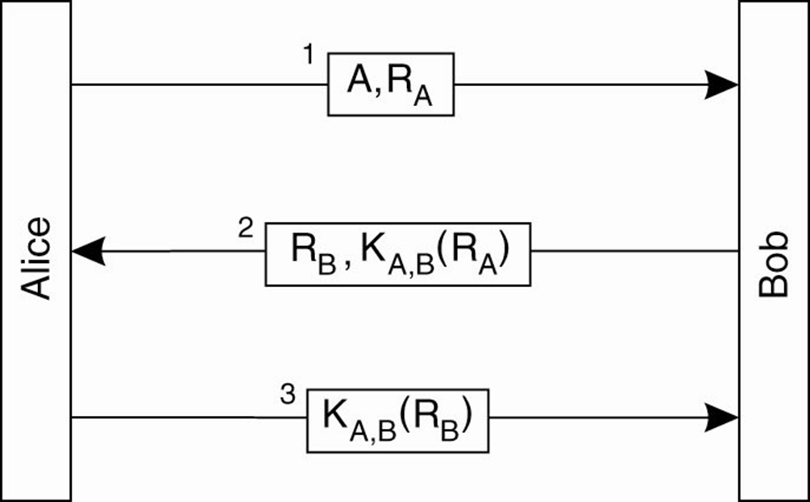
Authentication Based on a Shared Secret Key (2)
Bina Nusantara University

Slide 13
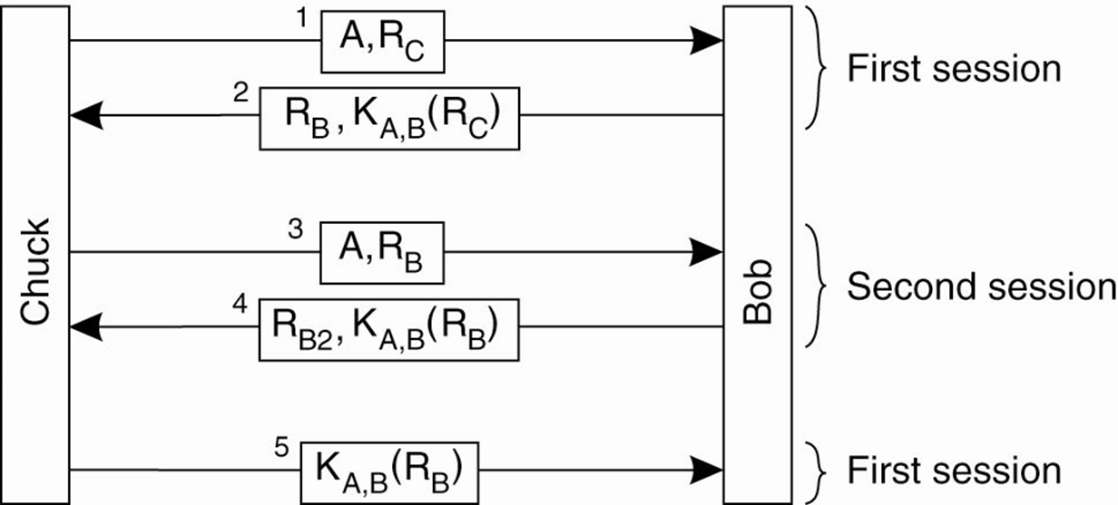
Authentication Based on a Shared Secret Key (3)
Bina Nusantara University

Slide 14
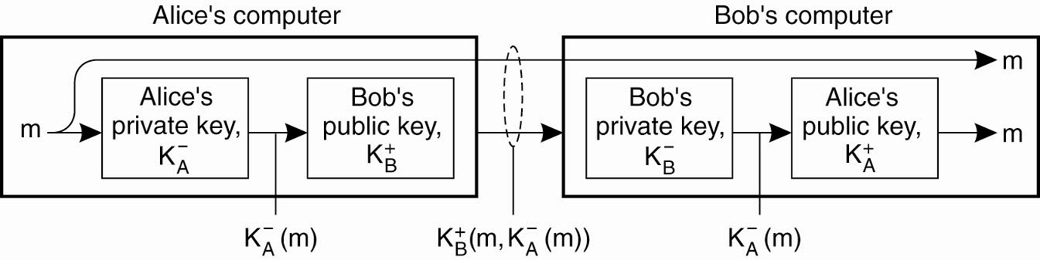
Digital Signatures (1)
Bina Nusantara University

Slide 15
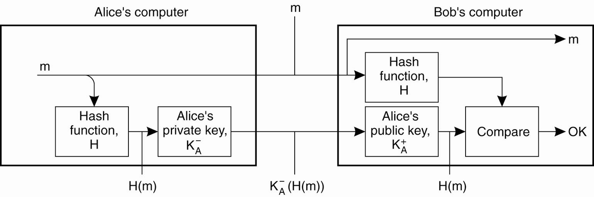
Digital Signatures (2)
Bina Nusantara University

Slide 16
DES (Data Encryption Standard)
Authors: NSA & IBM, 1977
Data block size: 64-bit (64-bit input, 64-bit output)
Key size: 56-bit key
Encryption is fast
  DES chips
  DES software: a 500-MIP CPU can encrypt at about 30K octets per second
Bina Nusantara University

Slide 17
Triple-DES (3DES)
C = DES_{k3}(DES_{k2}(DES_{k1}(P))).
Data block size: 64-bit
Key size: 168-bit key; effective key size: 112 (due to man-in-the-middle attack)
Encryption is slower than DES
Securer than DES
Bina Nusantara University

Slide 18
AES (Advanced Encryption Standard)
Authors: Daemen & Rijmen
Block size:128-bit
Key size: 128-bit, 192-bit, 256-bit
Encryption is fast
Security
  As of 2005, no successful attacks are recognized.
  NSA stated it secure enough for non-classified data.
Bina Nusantara University

